Slide 1
MergeSort

Slide 2
MergeSort
MergeSort is a divide and conquer method of sorting

Slide 3
MergeSort Algorithm
MergeSort is a recursive sorting procedure that uses at most O(n lg(n)) comparisons.
To sort an array of n elements, we perform the following steps in sequence:
If n < 2 then the array is already sorted.
Otherwise, n > 1, and we perform the following three steps in sequence:
  Sort the left half of the the array using MergeSort.
  Sort the right half of the the array using MergeSort.
  Merge the sorted left and right halves.

Slide 4
How to Merge
Here are two lists to be merged:
  First: (12, 16, 17, 20, 21, 27)
  Second: (9, 10, 11, 12, 19)
Compare12 and 9
  First: (12, 16, 17, 20, 21, 27)
  Second: (10, 11, 12, 19)
  New: (9)
Compare 12 and 10
  First: (12, 16, 17, 20, 21, 27)
  Second: (11, 12, 19)
  New: (9, 10)

Slide 5
Merge Example
Compare 12 and 11
  First: (12, 16, 17, 20, 21, 27)
  Second: (12, 19)
  New: (9, 10, 11)
Compare 12 and 12
  First: (16, 17, 20, 21, 27)
  Second: (12, 19)
  New: (9, 10, 11, 12)

Slide 6
Merge Example
Compare 16 and 12
  First: (16, 17, 20, 21, 27)
  Second: (19)
  New: (9, 10, 11, 12, 12)
Compare 16 and 19
  First: (17, 20, 21, 27)
  Second: (19)
  New: (9, 10, 11, 12, 12, 16)

Slide 7
Merge Example
Compare 17 and 19
  First: (20, 21, 27)
  Second: (19)
  New: (9, 10, 11, 12, 12, 16, 17)
Compare 20 and 19
  First: (20, 21, 27)
  Second: ( )
  New: (9, 10, 11, 12, 12, 16, 17, 19)

Slide 8
Merge Example
Checkout 20 and empty list
  First: ( )
  Second: ( )
  New: (9, 10, 11, 12, 12, 16, 17, 19, 20, 21, 27)

Slide 9
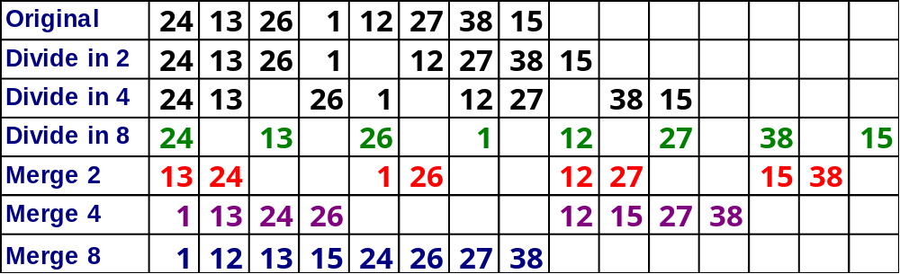
MergeSort

Slide 10
Merge-Sort Tree
An execution of merge-sort is depicted by a binary tree
  each node represents a recursive call of merge-sort and stores
    unsorted sequence before the execution and its partition
    sorted sequence at the end of the execution
  the root is the initial call
  the leaves are calls on subsequences of size 0 or 1
7 2 ⏐ 9 4 → 2 4 7 9
7 ⏐ 2 → 2 7
9 ⏐ 4 → 4 9
7 → 7
2 → 2
9 → 9
4 → 4

Slide 11
Execution Example
Partition
7 2 9 4 ⏐ 3 8 6 1

Slide 12
Execution Example (cont.)
Recursive call, partition
7 2 9 4 ⏐ 3 8 6 1
7 2 ⏐ 9 4

Slide 13
Execution Example (cont.)
Recursive call, partition
7 2 9 4 ⏐ 3 8 6 1
7 2 ⏐ 9 4
7 ⏐ 2

Slide 14
Execution Example (cont.)
Recursive call, base case
7 2 9 4 ⏐ 3 8 6 1
7 2 ⏐ 9 4
7 ⏐ 2
7 → 7

Slide 15
Execution Example (cont.)
Recursive call, base case
7 2 9 4 ⏐ 3 8 6 1
7 2 ⏐ 9 4
7 ⏐ 2
7 → 7
2 → 2

Slide 16
Execution Example (cont.)
Merge
7 2 9 4 ⏐ 3 8 6 1
7 2 ⏐ 9 4
7 ⏐ 2 → 2 7
7 → 7
2 → 2

Slide 17
Execution Example (cont.)
Recursive call, …, base case, merge
7 2 9 4 ⏐ 3 8 6 1
7 2 ⏐ 9 4
7 ⏐ 2 → 2 7
9 4 → 4 9
7 → 7
2 → 2
9 → 9
4 → 4

Slide 18
Execution Example (cont.)
Merge
7 2 9 4 ⏐ 3 8 6 1
7 2 ⏐ 9 4 → 2 4 7 9
7 ⏐ 2 → 2 7
9 4 → 4 9
7 → 7
2 → 2
9 → 9
4 → 4

Slide 19
Execution Example (cont.)
Recursive call, …, merge, merge
7 2 9 4 ⏐ 3 8 6 1
7 2 ⏐ 9 4 → 2 4 7 9
3 8 6 1 → 1 3 6 8
7 ⏐ 2 → 2 7
9 4 → 4 9
3 8 → 3 8
6 1 → 1 6
7 → 7
2 → 2
9 → 9
4 → 4
3 → 3
8 → 8
6 → 6
1 → 1

Slide 20
Execution Example (cont.)
Merge
7 2 9 4 ⏐ 3 8 6 1 → 1 2 3 4 6 7 8 9
7 2 ⏐ 9 4 → 2 4 7 9
3 8 6 1 → 1 3 6 8
7 ⏐ 2 → 2 7
9 4 → 4 9
3 8 → 3 8
6 1 → 1 6
7 → 7
2 → 2
9 → 9
4 → 4
3 → 3
8 → 8
6 → 6
1 → 1

Slide 21
Complexity of MergeSort
Pass Number | Number of merges | Merge list length | # of comps / moves per merge
1 | 2^{k-1} or n/2 | 1 or n/2^{k} | ≤ 2¹
2 | 2^{k-2} or n/4 | 2 or n/2^{k-1} | ≤ 2²
3 | 2^{k-3} or n/8 | 4 or n/2^{k-2} | ≤ 2³
. | . | . | .
. | . | . | .
. | . | . | .
k – 1 | 2¹ or n/2^{k-1} | 2^{k-2} or n/4 | ≤ 2^{k-1}
k | 2⁰ or n/2^{k} | 2^{k-1} or n/2 | ≤ 2^{k}
k = log n

Slide 22
Complexity of MergeSort
Multiplying the number of merges by the maximum number of comparisons per merge, we get:
(2^{k-1})2¹ = 2^{k}
(2^{k-2})2² = 2^{k}
•
•
•
(2¹)2^{k-1} = 2^{k}
(2⁰)2^{k} = 2^{k}
k passes each require 2^{k} comparisons (and moves). But k = lg n and hence, we get lg(n) • n comparisons or O(n lgn)

Slide 23
Sorting
Insertion sort
  Design approach:
  Sorts in place:
  Best case:
  Worst case:
Bubble Sort
  Design approach:
  Sorts in place:
  Running time:
incremental
Yes
Θ(n)
Θ(n²)
incremental
Yes
Θ(n²)

Slide 24
Sorting
Selection sort
  Design approach:
  Sorts in place:
  Running time:
Merge Sort
  Design approach:
  Sorts in place:
  Running time:
incremental
Yes
Θ(n²)
divide and conquer
No
Let’s see!!

Slide 25
Divide-and-Conquer
Divide the problem into a number of sub-problems
  Similar sub-problems of smaller size
Conquer the sub-problems
  Solve the sub-problems recursively
  Sub-problem size small enough ⇒ solve the problems in straightforward manner
Combine the solutions of the sub-problems
  Obtain the solution for the original problem

Slide 26
Merge Sort Approach
To sort an array A[p . . r]:
Divide
  Divide the n-element sequence to be sorted into two subsequences of n/2 elements each
Conquer
  Sort the subsequences recursively using merge sort
  When the size of the sequences is 1 there is nothing more to do
Combine
  Merge the two sorted subsequences

Slide 27
Merge Sort
p
q
r
1
2
3
4
5
6
7
8
Alg.: MERGE-SORT(A, p, r)
if p < r Check for base case
then q ← ⎣(p + r)/2⎦ Divide
MERGE-SORT(A, p, q) Conquer
MERGE-SORT(A, q + 1, r) Conquer
MERGE(A, p, q, r) Combine
Initial call: MERGE-SORT(A, 1, n)
5
2
4
7
1
3
2
6

Slide 28
Example – n Power of 2
Divide
1
2
3
4
5
6
7
8
5
2
4
7
1
3
2
6
q = 4
1
2
3
4
5
6
7
8
5
2
4
7
1
3
2
6
1
2
3
4
5
6
7
8
5
2
4
7
1
3
2
6
1
2
3
4
5
6
7
8
5
2
4
7
1
3
2
6

Slide 29
Example – n Power of 2
Conquer
and
Merge
1
2
3
4
5
6
7
8
1
2
2
3
4
5
6
7
1
2
3
4
5
6
7
8
2
4
5
7
1
2
3
6
1
2
3
4
5
6
7
8
2
5
4
7
1
3
2
6
1
2
3
4
5
6
7
8
5
2
4
7
1
3
2
6

Slide 30
Example – n Not a Power of 2
1
2
3
4
5
6
7
8
9
10
11
Divide
4
7
2
6
1
4
7
3
5
2
6
q = 6
1
2
3
4
5
6
7
8
9
10
11
q = 3
4
7
2
6
1
4
7
3
5
2
6
q = 9
1
2
3
4
5
6
7
8
9
10
11
4
7
2
6
1
4
7
3
5
2
6
1
2
3
4
5
6
7
8
9
10
11
4
7
2
6
1
4
7
3
5
2
6
1
2
4
5
7
8
4
7
6
1
7
3

Slide 31
Example – n Not a Power of 2
Conquer
and
Merge
1
2
3
4
5
6
7
8
9
10
11
1
2
2
3
4
4
5
6
6
7
7
1
2
3
4
5
6
7
8
9
10
11
1
2
4
4
6
7
2
3
5
6
7
1
2
3
4
5
6
7
8
9
10
11
2
4
7
1
4
6
3
5
7
2
6
1
2
3
4
5
6
7
8
9
10
11
4
7
2
1
6
4
3
7
5
2
6
1
2
4
5
7
8
4
7
6
1
7
3

Slide 32
Merging
p
q
r
1
2
3
4
5
6
7
8
2
4
5
7
1
2
3
6
Input: Array A and indices p, q, r such that p ≤ q < r
  Subarrays A[p . . q] and A[q + 1 . . r] are sorted
Output: One single sorted subarray A[p . . r]

Slide 33
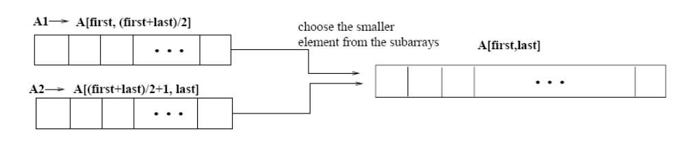
Merging
p
q
r
Idea for merging:
  Two piles of sorted cards
    Choose the smaller of the two top cards
    Remove it and place it in the output pile
  Repeat the process until one pile is empty
  Take the remaining input pile and place it face-down onto the output pile
1
2
3
4
5
6
7
8
2
4
5
7
1
2
3
6
A1← A[p, q]
A[p, r]
A2← A[q+1, r]

Slide 34
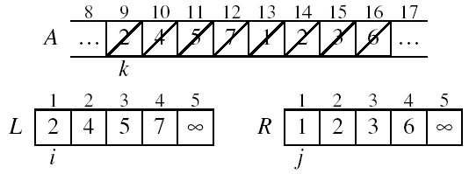
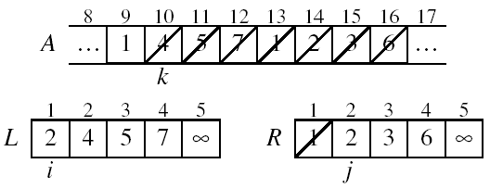
Example: MERGE(A, 9, 12, 16)
p
q
r

Slide 35
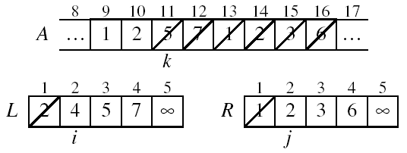
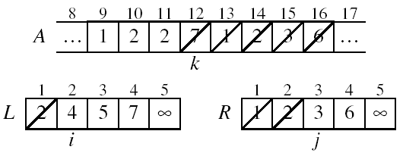
Example: MERGE(A, 9, 12, 16)

Slide 36
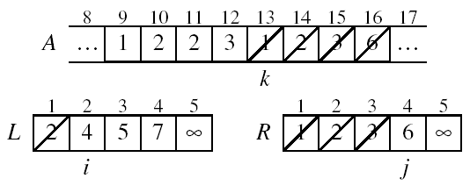
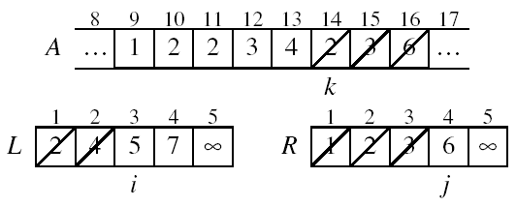
Example (cont.)

Slide 37
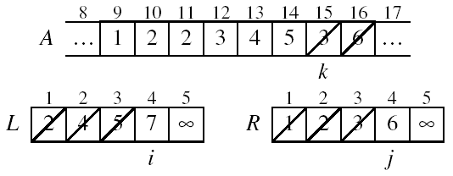
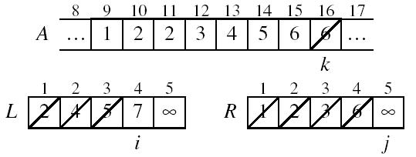
Example (cont.)

Slide 38
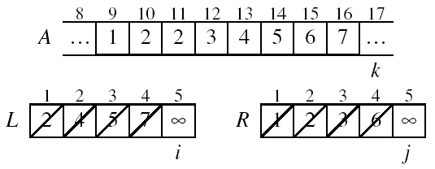
Example (cont.)
Done!

Slide 39
Merge - Pseudocode
p
q
r
Alg.: MERGE(A, p, q, r)
Compute n₁ and n₂
Copy the first n₁ elements into L[1 . . n₁ + 1] and the next n₂ elements into R[1 . . n₂ + 1]
L[n₁ + 1] ← ∞; R[n₂ + 1] ← ∞
i ← 1; j ← 1
for k ← p to r
do if L[ i ] ≤ R[ j ]
then A[k] ← L[ i ]
i ←i + 1
else A[k] ← R[ j ]
j ← j + 1
1
2
3
4
5
6
7
8
2
4
5
7
1
2
3
6
n₁
n₂
p
q
L
2
4
5
7
∞
q + 1
r
R
1
2
3
6
∞

Slide 40
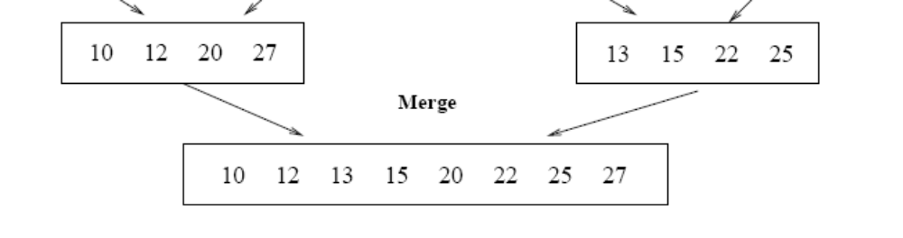
Running Time of Merge
(assume last for loop)
Initialization (copying into temporary arrays):
  Θ(n₁ + n₂) = Θ(n)
Adding the elements to the final array:
  - n iterations, each taking constant time ⇒ Θ(n)
Total time for Merge:
  Θ(n)

Slide 41
Analyzing Divide-and Conquer Algorithms
The recurrence is based on the three steps of the paradigm:
  T(n) – running time on a problem of size n
  Divide the problem into a subproblems, each of size n/b: takes D(n)
  Conquer (solve) the subproblems aT(n/b)
  Combine the solutions C(n)
Θ(1) if n ≤ c
T(n) = aT(n/b) + D(n) + C(n) otherwise

Slide 42
MERGE-SORT Running Time
Divide:
  compute q as the average of p and r: D(n) = Θ(1)
Conquer:
  recursively solve 2 subproblems, each of size n/2 ⇒ 2T (n/2)
Combine:
  MERGE on an n-element subarray takes Θ(n) time ⇒ C(n) = Θ(n)
Θ(1) if n =1
T(n) = 2T(n/2) + Θ(n) if n > 1

Slide 43
Solve the Recurrence
T(n) = c if n = 1
2T(n/2) + cn if n > 1
Use Master’s Theorem:
Compare n with f(n) = cn
Case 2: T(n) = Θ(nlgn)

Slide 44
Merge Sort - Discussion
Running time insensitive of the input
Advantages:
  Guaranteed to run in Θ(nlgn)
Disadvantage
  Requires extra space ≈N

Slide 45
Sorting Challenge 1
Problem: Sort a file of huge records with tiny keys
Example application: Reorganize your MP-3 files
Which method to use?
  merge sort, guaranteed to run in time ∼NlgN
  selection sort
  bubble sort
  a custom algorithm for huge records/tiny keys
  insertion sort

Slide 46
Sorting Files with Huge Records and Small Keys
Insertion sort or bubble sort?
  NO, too many exchanges
Selection sort?
  YES, it takes linear time for exchanges
Merge sort or custom method?
  Probably not: selection sort simpler, does less swaps

Slide 47
Sorting Challenge 2
Problem: Sort a huge randomly-ordered file of small records
Application: Process transaction record for a phone company
Which sorting method to use?
  Bubble sort
  Selection sort
  Mergesort guaranteed to run in time ∼NlgN
  Insertion sort

Slide 48
Sorting Huge, Randomly - Ordered Files
Selection sort?
  NO, always takes quadratic time
Bubble sort?
  NO, quadratic time for randomly-ordered keys
Insertion sort?
  NO, quadratic time for randomly-ordered keys
Mergesort?
  YES, it is designed for this problem

Slide 49
Sorting Challenge 3
Problem: sort a file that is already almost in order
Applications:
  Re-sort a huge database after a few changes
  Doublecheck that someone else sorted a file
Which sorting method to use?
  Mergesort, guaranteed to run in time ∼NlgN
  Selection sort
  Bubble sort
  A custom algorithm for almost in-order files
  Insertion sort

Slide 50
Sorting Files That are Almost in Order
Selection sort?
  NO, always takes quadratic time
Bubble sort?
  NO, bad for some definitions of “almost in order”
  Ex: B C D E F G H I J K L M N O P Q R S T U V W X Y Z A
Insertion sort?
  YES, takes linear time for most definitions of “almost in order”
Mergesort or custom method?
  Probably not: insertion sort simpler and faster

Slide 51
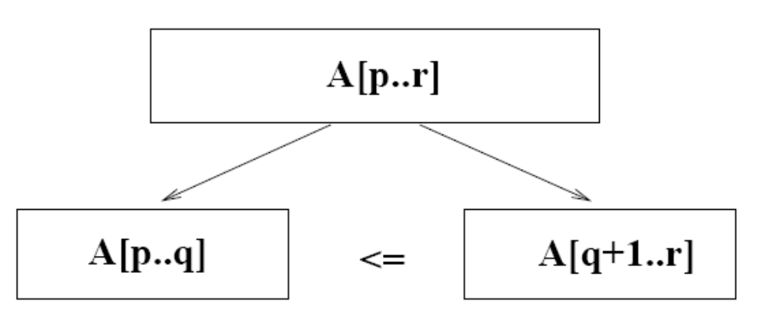
Quicksort
A[p…q]
≤
A[q+1…r]
Sort an array A[p…r]
Divide
  Partition the array A into 2 subarrays A[p..q] and A[q+1..r], such that each element of A[p..q] is smaller than or equal to each element in A[q+1..r]
  Need to find index q to partition the array

Slide 52
Quicksort
A[p…q]
≤
A[q+1…r]
Conquer
  Recursively sort A[p..q] and A[q+1..r] using Quicksort
Combine
  Trivial: the arrays are sorted in place
  No additional work is required to combine them
  The entire array is now sorted

Slide 53
QUICKSORT
Alg.: QUICKSORT(A, p, r)
if p < r
then q ← PARTITION(A, p, r)
QUICKSORT (A, p, q)
QUICKSORT (A, q+1, r)
Initially: p=1, r=n
Recurrence:
T(n) = T(q) + T(n – q) + f(n)
PARTITION())

Slide 54
Partitioning the Array
Choosing PARTITION()
  There are different ways to do this
  Each has its own advantages/disadvantages
Hoare partition (see prob. 7-1, page 159)
  Select a pivot element x around which to partition
  Grows two regions
A[p…i] ≤ x
x ≤ A[j…r]
A[p…i] ≤ x
x ≤ A[j…r]
i
j

Slide 55
Example
A[p…r]
pivot x=5
5
3
2
6
4
1
3
7
5
3
2
6
4
1
3
7
i
j
i
j
3
3
2
6
4
1
5
7
3
3
2
6
4
1
5
7
i
j
i
j
A[p…q]
A[q+1…r]
3
3
2
1
4
6
5
7
3
3
2
1
4
6
5
7
i
j
j
i

Slide 56
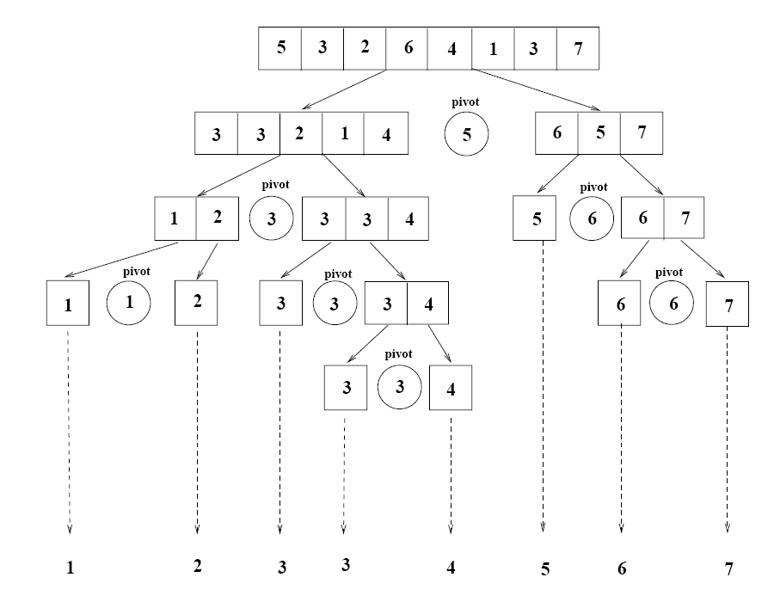
Example

Slide 57
Partitioning the Array
Alg. PARTITION (A, p, r)
x ← A[p]
i ← p – 1
j ← r + 1
while TRUE
do repeat j ← j – 1
until A[j] ≤ x
do repeat i ← i + 1
until A[i] ≥ x
if i < j
then exchange A[i] ↔ A[j]
else return j
p
r
A:
5
3
2
6
4
1
3
7
i
j
A[p…q]
≤
A[q+1…r]
A:
a_{p}
a_{r}
j=q
i
Each element is
visited once!
Running time: Θ(n)
n = r – p + 1

Slide 58
Recurrence
Alg.: QUICKSORT(A, p, r)
if p < r
then q ← PARTITION(A, p, r)
QUICKSORT (A, p, q)
QUICKSORT (A, q+1, r)
Initially: p=1, r=n
Recurrence:
T(n) = T(q) + T(n – q) + n

Slide 59
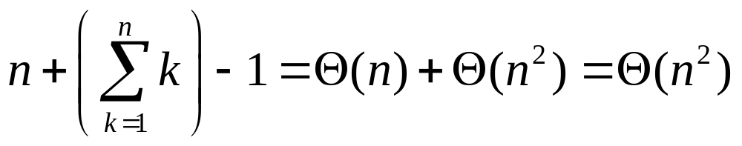
Worst Case Partitioning
Worst-case partitioning
  One region has one element and the other has n – 1 elements
  Maximally unbalanced
Recurrence: q=1
  T(n) = T(1) + T(n – 1) + n,
  T(1) = Θ(1)
  T(n) = T(n – 1) + n
  =
n
n
1
n - 1
n
1
n - 2
n - 1
n
1
n - 3
n - 2
1
2
3
1
1
2
Θ(n²)
When does the worst case happen?

Slide 60
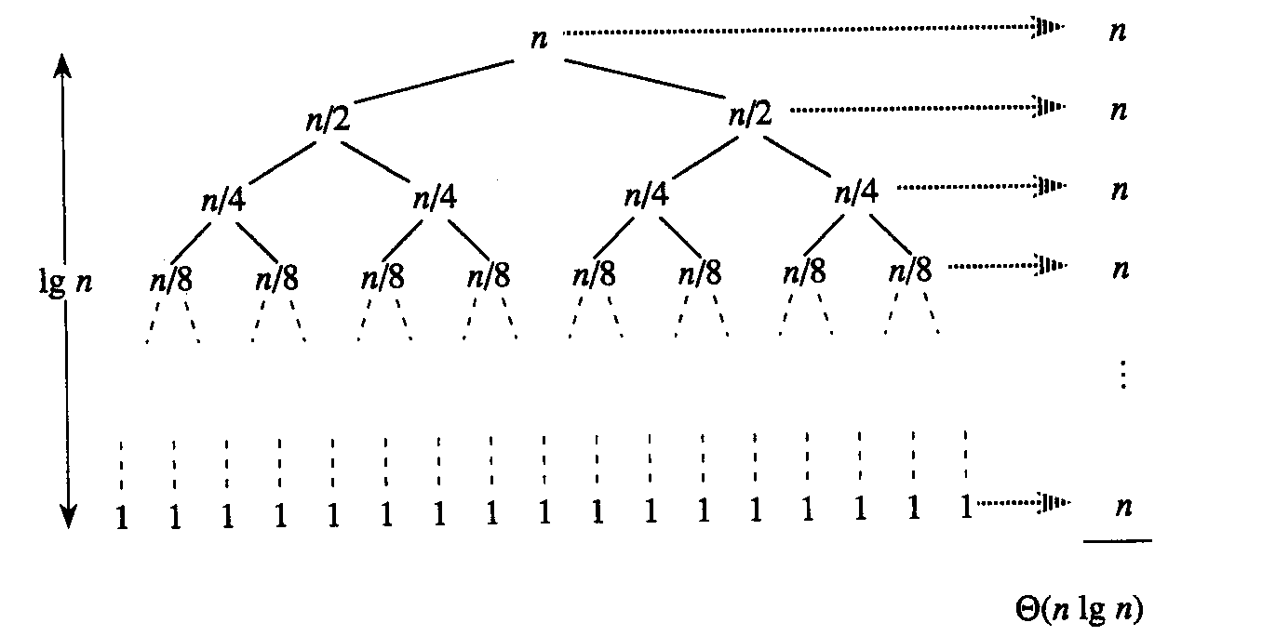
Best Case Partitioning
Best-case partitioning
  Partitioning produces two regions of size n/2
Recurrence: q=n/2
  T(n) = 2T(n/2) + Θ(n)
  T(n) = Θ(nlgn) (Master theorem)

Slide 61
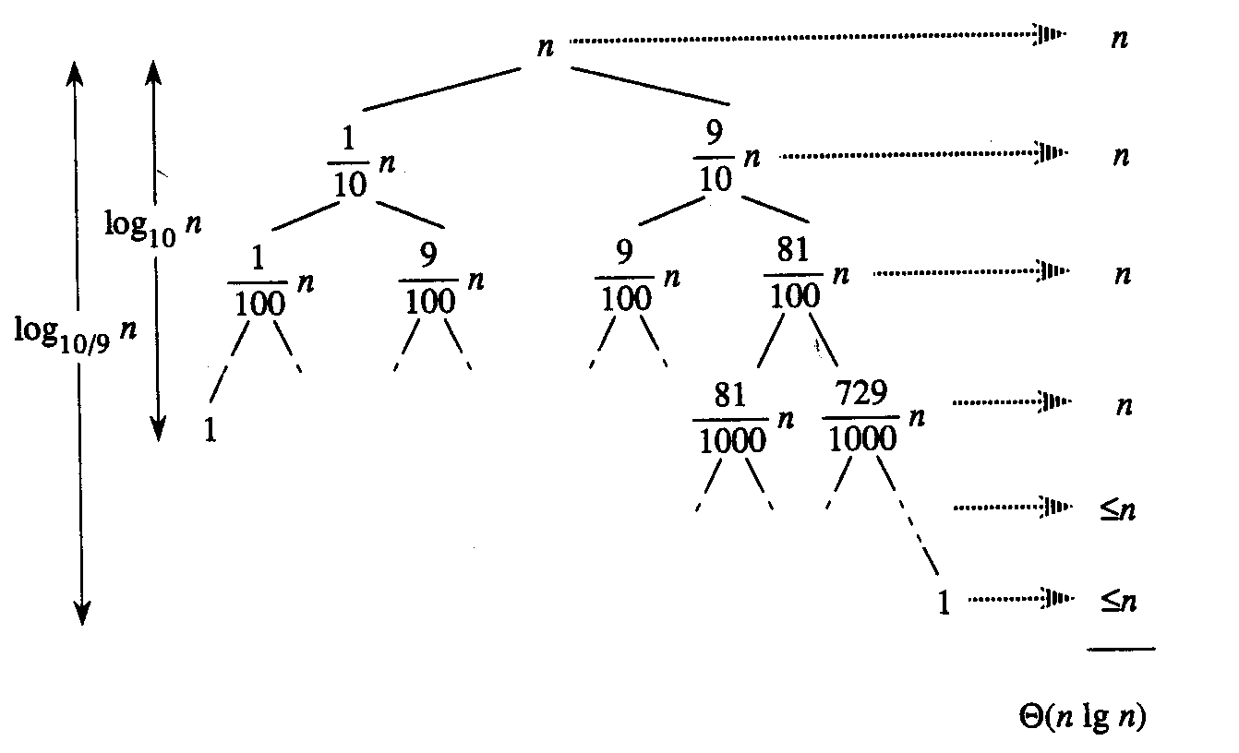
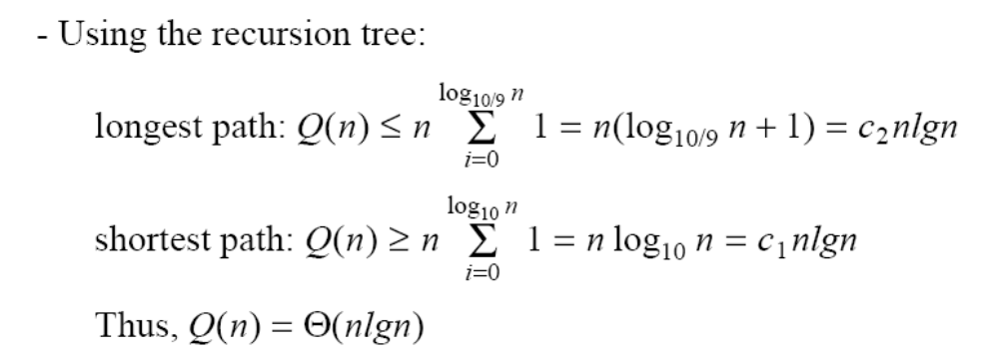
Case Between Worst and Best
9-to-1 proportional split
Q(n) = Q(9n/10) + Q(n/10) + n

Slide 62
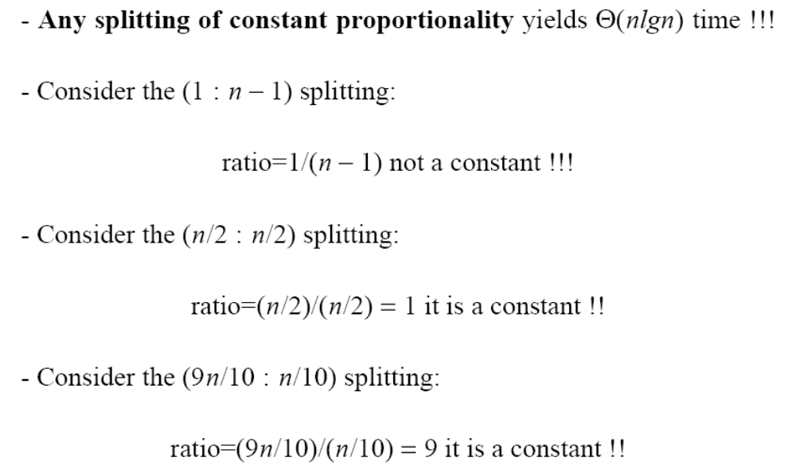
How does partition affect performance?

Slide 63
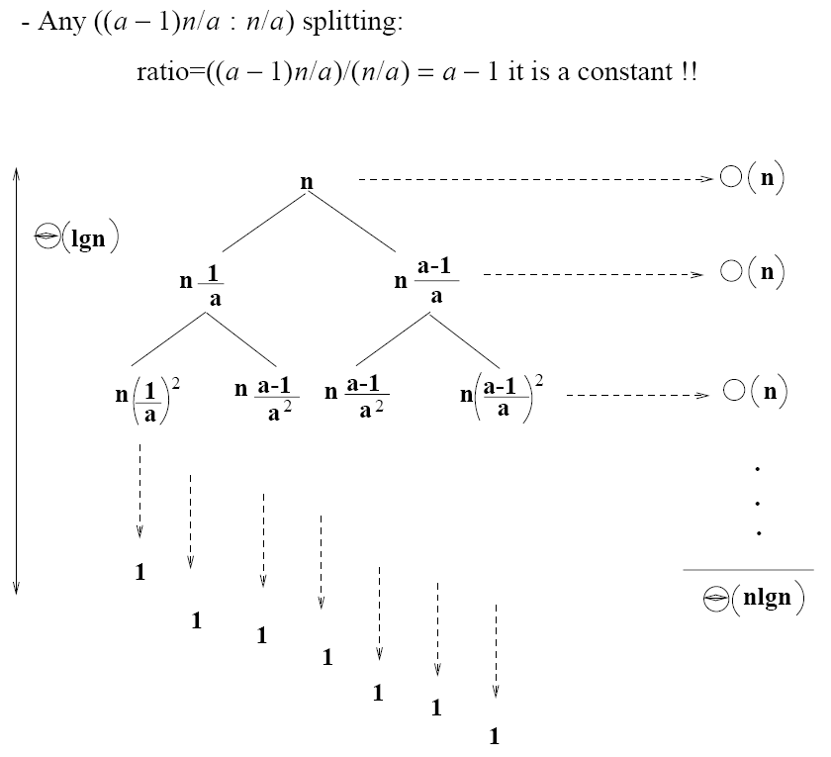
How does partition affect performance?

Slide 64
Performance of Quicksort
Average case
  All permutations of the input numbers are equally likely
  On a random input array, we will have a mix of well balanced and unbalanced splits
  Good and bad splits are randomly distributed across throughout the tree
partitioning cost:
n = Θ(n)
n
combined partitioning cost:
2n-1 = Θ(n)
n
1
n - 1
(n – 1)/2 + 1
(n – 1)/2
(n – 1)/2
(n – 1)/2
Alternate of a good
and a bad split
Nearly well
balanced split
Running time of Quicksort when levels alternate between good and bad splits is O(nlgn)

